Slide 1

Energy Consumption Analysis

Slide 2



Energy Consumption

Slide 3

Introduction
The global energy sector requires effective management of energy production, consumption, emissions, and GDP categories.
Efficient data handling helps track energy usage and generation, monitor resource availability, and analyze sustainability performance.
This project simulates a worldwide energy database with interconnected entities such as energy consumption, production, emissions, GDP, and population.
It offers hands-on experience in understanding data relationships and global economic–environmental interactions.
Students will use SQL to extract and transform data, gaining valuable insights into energy trends.
The goal is to improve decision-making and sustainability planning through data-driven analysis.

Slide 4
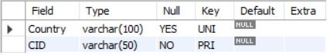
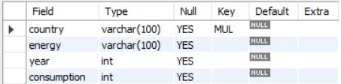
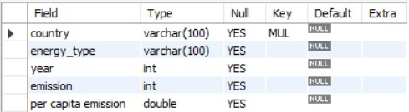
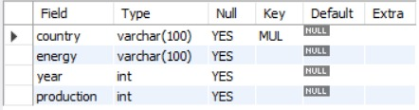
Tables
Country Table
Consumption Table
Emission Table
Production Table

Slide 5
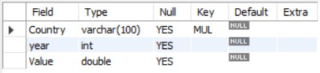
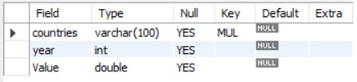
Tables
GDP Table
Consumption Table

Slide 6
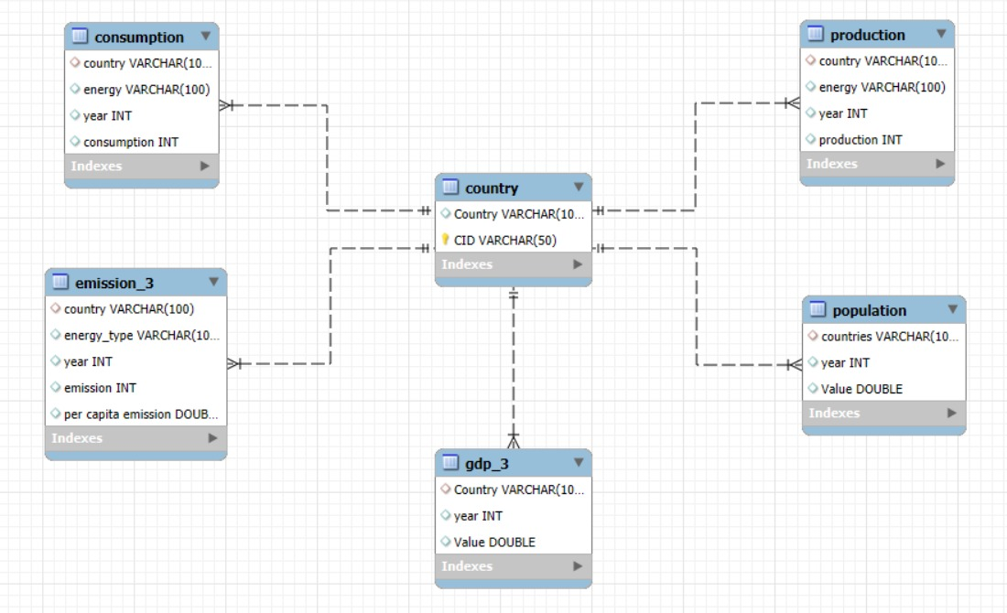
ER Diagram

Slide 7
Problem Statement
In the dynamic landscape of the global energy sector, managing and analyzing large volumes of data related to energy production, consumption, emissions, and resources is crucial for sustainable operations and informed decision-making. This project aims to design and implement a relational database system that captures essential energy sector activities and enables users to retrieve and analyze data through SQL. The system will support complex queries to identify key insights such as top energy-consuming countries, leading energy producers, and emission trends, while reinforcing practical SQL skills including joins, aggregations, subqueries, and filtering.

Slide 8

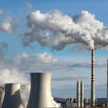
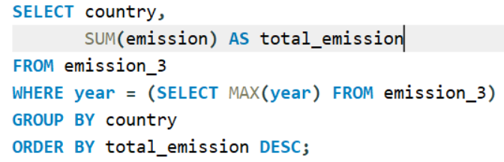

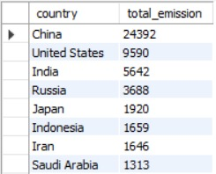
1.What is the total emission per country for the most recent year available?

Slide 9
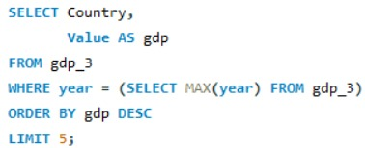
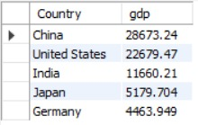
2.What are the top 5 countries by GDP in the most recent year?

Slide 10
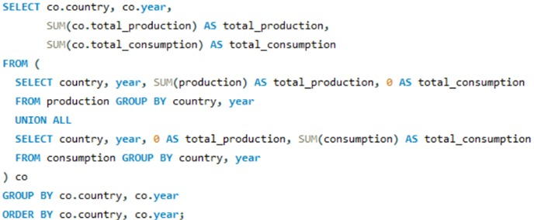
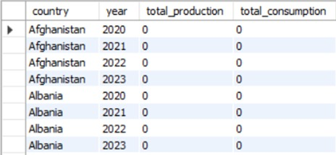
3.Compare energy production and consumption by country and year.

Slide 11
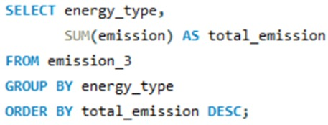
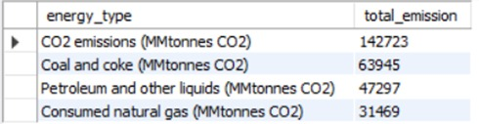
4.Which energy types contribute most to emissions across all countries?

Slide 12
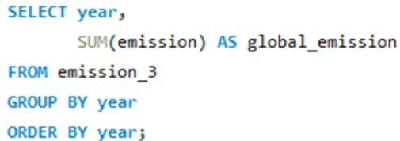
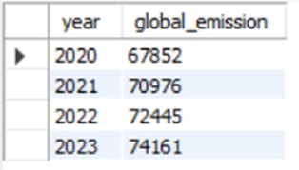
5.How have global emissions changed year over year?

Slide 13
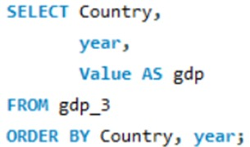
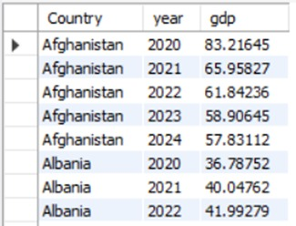
6.What is the trend in GDP for each country over the given years?

Slide 14
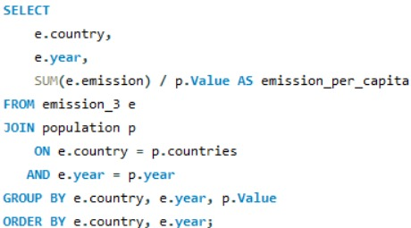
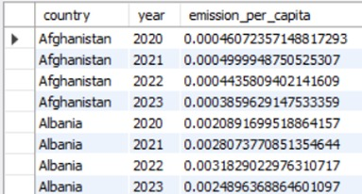
7.How has population growth affected total emissions in each country?

Slide 15
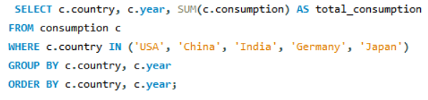
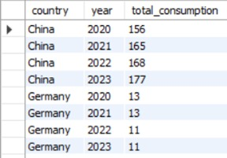
8.Has energy consumption increased or decreased over the years for major economies?

Slide 16
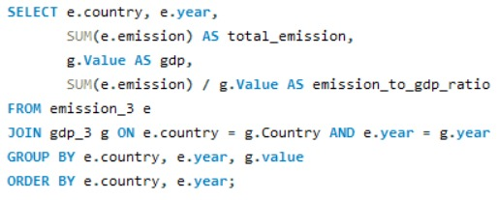
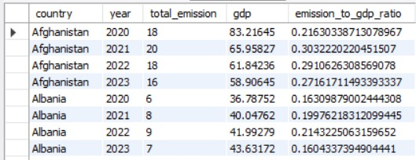
10) What is the emission-to-GDP ratio for each country by year?

Slide 17
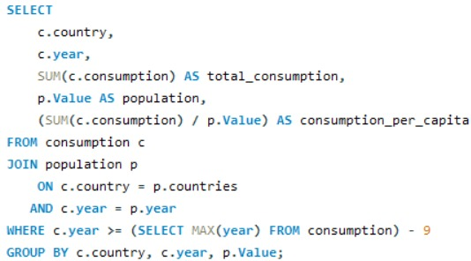
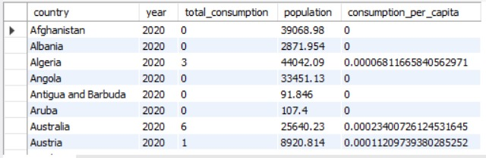
11) What is the energy consumption per capita for each country over the last decade?

Slide 18
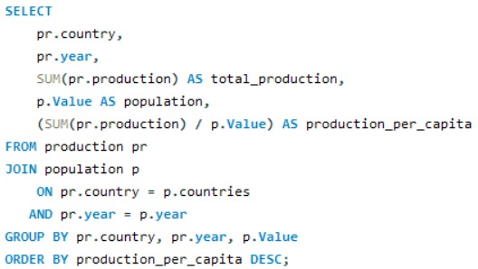
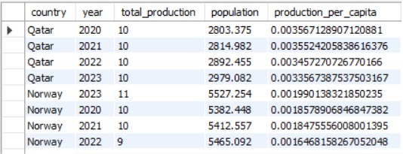
12) How does energy production per capita vary across countries?

Slide 19
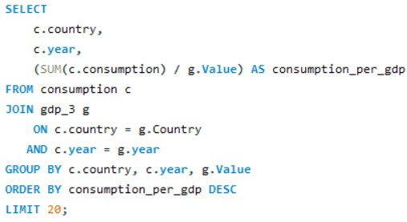
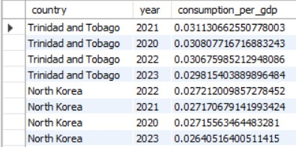
13) Which countries have the highest energy consumption relative to GDP?

Slide 20




Thank You for your attention
Group Members:
K Sudheer Kumar
K V Jayavardhan
Mahesh

